Slide 1
Enhancing Mortality Prediction in ICU: A Deep Learning Framework for Multivariate Time Series Classification

Slide 2
INTRODUCTION
In ICU settings, reliance on human diagnosis poses risks due to time constraints and potential errors. Existing severity scoring methods lack integration of dynamic patient data from Electronic Health Records (EHRs), hindering accurate prognosis. Recent advancements in survival analysis methods emphasize the need to leverage time-varying EHR data for improved mortality prediction and treatment decisions so that it can address the gaps in current approaches.

Slide 3
OBJECTIVE
To develop a in-ICU mortality prediction model by using TCN-BiGRU Deep Learning technique.
The TCN-Bi GRU model aims to leverage temporal dynamics, learn the hierarchical features from diverse data sources
Mitigate the impact of missing values in EHR data through the application of Generative Adversarial Network (GAN)-based imputation techniques, ensuring robustness and reliability of the predictive model
To better understand the factors contributing to mortality risk among ICU patients by extracting informative features from the data, facilitating insights into patient prognosis and clinical decision-making.

Slide 4
LITERATURE SURVEY
S.no | Title | Author | Findings | Limitations
1) | Improving the In-Hospital Mortality Prediction of Diabetes ICU Patients Using a Process Mining/Deep Learning Architecture | Julian Theis, William L. Galanter, Andrew D. Boyd, Houshang Darabi. | An adaptation of Decay Replay Mining - combines medical and demographic information with established severity scores to predict the in hospital mortality of dia betes ICU patients. | This approach addresses hospitals with a strong longitudinal patient record and may not be useful for ones with minimal longitudinal patient history.
2) | MedCT-BERT: A Novel Medical Multimodal Model for Mortality Prediction in Intensive Care Units | Ke Zhang, Ke Niu, Yuhang Zhou, Wenjuan Tai, Guoqiang Lu | MedCT BERT -address the irregularity of time-series data. GAIN model - handling missing values in the data. | The imputation method in the model does not consider the correlation information among the time-series features.

Slide 5
S.no | Title | Author | Findings | Limitations
3) | FineEHR: A System for Refining Clinical Note Representations for Accurate Mortality Prediction | Jun Wu, Xuesong Ye, Chengjie Mou, Weinan Dai | FineEHR utilizes word embeddings and pooling methods to represent ICU patients' clinical notes. The integration techniques refines embedding, contributing to improved prognostic performance in ICU settings. | It only presents the Area Under Curve result of mortality prediction
4) | Development of a Hybrid Model using Deep Neural Network and XGBOOST for Mortality Prediction of ICU Patients | Babita Majhi, Aarti Kashyap | The study suggests a hybrid model (DNN+XGB) for ICU patient mortality prediction, showing superior performance compared to Gaussian SVM and Multinomial NB. | Using only one dataset, neglecting patient factors, insufficiently explaining preprocessing techniques, and lacking detail on model architecture and hyperparameters.

Slide 6
S.no | Title | Author | Findings | Limitations
5) | Missing Value Imputation Methods for Electronic Health Records | K. Psychogyios, L. Ilias, C. Ntanos and D. Askounis | The paper introduces deep learning approaches (DAE and GANs) for missing value imputation in EHR, outperforming traditional methods. | Only evaluates methods on four EHR datasets, lacks testing on diverse/larger datasets. Focuses solely on imputation and post-imputation tasks, neglecting other potential use cases for imputed data.

Slide 7
S.no | Title | Author | Findings | Limitations
6) | TCN-Based Distal Force Feedback Strategy of a Vascular Interventional Surgery Robot | Shuang Wang, Hao Shen, Zheng Liu, Le Xie | To solve the mechanism design and force feedback challenges, a novel VIS robotic system equipped with a force-sensing mechanism is developed with temporal convolutional network (TCN) for the guidewire distal force prediction and an enhanced interactive force feedback strategy (EIFFS) are proposed to improve the safety of the robotic system | Nonetheless, the current study is still limited, we will consider combining intraoperative DSA images to determine the posture of the guidewire and predict the distal force. In addition, developing a microguidewire force sensor based on fiber Bragg grating (FBG) is also a solution worth exploring.

Slide 8
S.no | Title | Author | Findings | Limitations
7) | A Novel Deep Learning Bi-GRU-I Model for Real-Time Human Activity Recognition Using Inertial Sensors | Lina Tong, Hanghang Ma, Qianzhi Lin, Jiaji He | The dataset of Command Actions of Traffic Police (CATP) was acquired. Then, a deep learning model named Bidirectional-Gated Recurrent Unit-Inception (Bi-GRU-I) was designed to improve the accuracy and reduce the amount of parameters. | In future work, the proposed method and device will be further improved and put into practice for rehabilitation training project. And the CATP dataset will be public after this paper be published.

Slide 9
S.no | Title | Author | Findings | Limitations
8) | Predicting 90-Day Mortality for ICU Trauma Patients with a Machine Learning Algorithm Using XGBoost Using MIMIC-III Database. | Shan Yang1 , Lirui Cao2 , Yongfang Zhou3 , Chenggong Hu | Common scoring systems include the Injury Severity Scale (ISS), Revised Trauma Score (RTS), and Trauma and Injury Severity Score (TRISS).6 Cook et al compared the Trauma Audit and Research Network (TARN) with the Trauma Mortality Prediction Mode (TMPM). TMPM should be considered a measure of injury severity | This simple yet powerful mortality prediction model can be used to assist clinicians in early identification of mortality risk factors and early intervention to reduce mortality, particularly in patients whose condition is rapidly deteriorating

Slide 10
S.no | Title | Author | Findings | Limitations
9) | Prediction of Short-Term Mortality of Cardiac Care Unit Patients Using Image-Transformed ECG Waveforms | Terumasa Kondo , Atsushi Teramoto, Eiichi Watanabe, Yoshihiro Sobue , Hideo Izawa, Kuniaki Saito , Hiroshi Fujita | A two-dimensional convolutional neural network (CNN) was used to predict the short-term prognosis of cardiac care unit (CCU) patients based on their ECG data. Visualization using gradcam showed that the CNN tended to focus on the shape and regularity of waveforms, such as heart failure and myocardial infarction. | The study did not evaluate the performance of the proposed method in comparison to other prognostic models or clinical risk scores.The gradcam visualization may lead to misinterpretation of the ECG waveforms, potentially leading to incorrect treatment decisions

Slide 11
S.no | Title | Author | Findings | Limitations
10) | TCN-Based Distal Force Feedback Strategy of a Vascular Interventional Surgery Robot | S. Wang, H. Shen, Z. Liu and L. Xie | The paper proposes TSCAN, a deep learning model for clinical data analysis in ICU. TSCAN uses an attention mechanism for improved prediction accuracy in mortality and length of stay. It identifies relevant clinical indicators and demonstrates better performance than other SOTA methods. | The study uses a small number of physiological variables and does not pay much attention to correlations of different variables.The proposed model may not be able to capture complex failure modes that cannot be represented by the imfs.

Slide 12
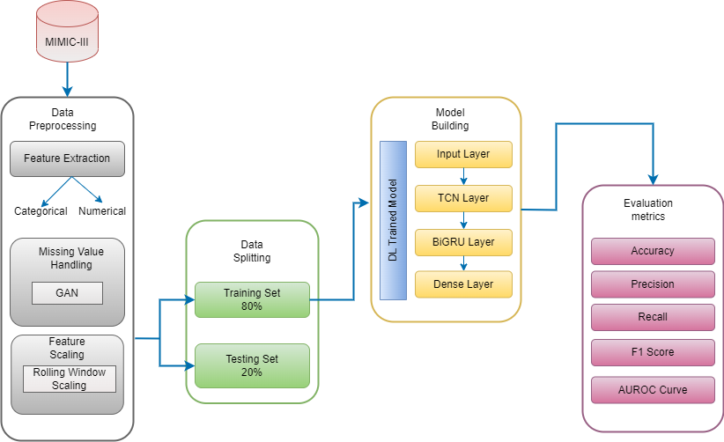
BLOCK DIAGRAM

Slide 13
Dataset Description
A popular, publicly available database called MIMIC-III (Medical Information Mart for Intensive Care III) holds de-identified health-related information for more than 12,000 patients who were admitted to Beth Israel Deaconess Medical Centre critical care units between 2001 and 2012.

Slide 14
Dataset Attributes
Age | Diabetes | Heartbeats
Gender | Deficiency Anaemias | Systolic Blood Pressure
BMI | Depression | Diastolic Blood Pressure
Hypertensive | Hyperlipemia | Respiratory Rate
Atrial Fibrillation | Renal Failure | Temperature Data
CHD with no MI | COPD | SpO2
Platelets | MCHC | Urine Output
Neutrophils | MCV | Hematocrit
Lymphocytes | RDW | Red Blood Cells

Slide 15
List of Modules
Data Transformation: Categorical features
Phase 1
Data Imputation Using GAN
Rolling Window Scaling
Temporal Convolutional Network (TCN)
Bi-Directional GRU
Phase 2
Model Prediction
Model Evaluation

Slide 16
ALGORITHMS

Slide 17
Phase 1

Slide 18
Generative Adversarial Network
Input: Data01.csv: A CSV file containing the dataset with missing values. Output: A new CSV file ("complete_dataset.csv") containing the dataset with imputed values. 1. Load and Preprocess Data: data ← read_csv("Data01.csv") 2. Split the data into two frames: complete_rows ←data.rows_with_no_missing() incomplete_rows ← data.rows_with_missing() 3. Define input and output shapes for the GAN: input_shape ← number_of_features - 2 output_shape ← input_shape

Slide 19
4. Build GAN Models: Generator Model (build_generator): generator ← neural_network(inp_shape, out_shape) Discriminator Model (build_discriminator): discriminator ← neural_network(input_shape) 5. Train the Generator: train_generator(generator, discriminator, complete_rows) 6. Impute Missing Values: imputed_values ← generator.predict(incomplete_rows) incomplete_rows.fill_with(imputed_values) 7. Combine and Evaluate: complete_dataset ← concatenate(complete_rows, incomplete_rows) nrmse_scores ← calculate_nrmse(data, complete_dataset) 8. Save the imputed dataset to a new CSV file: save_to_csv(complete_dataset, "complete_dataset.csv")

Slide 20
Rolling Window Scaling
Input: CSV file named "complete_dataset.csv" containing a dataset with numerical features. Output: CSV file named "norm_dataset.csv" containing the dataset with features scaled using a rolling window approach. Data: Array containing the data for a single feature Window_size: Integer representing the size of the rolling window Initialize scaled_data as array with the same shape as data. For each window of size window_size in data: Define window as data[i:i+window_size]. Calculate max_abs_val as the maximum absolute value within window. If max_abs_val is not zero: Scale each element in window by dividing by max_abs_val. d. Otherwise, keep window values unchanged. e. Store scaled window values in corresponding positions of scaled_data. 3. Return scaled_data.

Slide 21
Phase 2

Slide 22
TCN – BiGRU
Import Libraries: Load Dataset: Load the CSV data file (final_data_v1.csv) using pd.read_csv. 3. Preprocess Data: Separate features (X) from the target variable (y). Split the data using train_test_split 4. Reshape Input Data: Reshape the training and testing data to add a new dimension. The new shape will be (samples, 1, features). 5. Define TCN Layer: nb_filters: Number of filters kernel_size: Size of the kernel nb_stacks: Number of stacked convolutional blocks dilations: List of dilation factors for causal convolutions return_sequences: Whether to return the entire sequence from the layer

Slide 23
6. Bi-directional GRU Layer: GRU: The inner GRU unit with the specified number of units return_sequences: Whether to return the entire sequence from the layer dropout: Fraction of units to drop for dropout() regularization recurrent_dropout: Fraction of units to drop for recurrent dropout 7. Output Layer: activation: Activation function sigmoid() for binary classification 8. Model Architecture: Pass input→ TCN layer. Flatten()→ output of the TCN layer Reshape() → flattened output for the Bi-directional GRU layer. TimeDistributed(), sigmoid() → binary classification. Pass to final output layer. 9. Compilation Compile the model with Adam() optimizer, binary cross-entropy() loss function, and accuracy metrics. 10. Train and Evaluate the Model: Print the test loss and accuracy. Compute Evaluation metrics

Slide 24
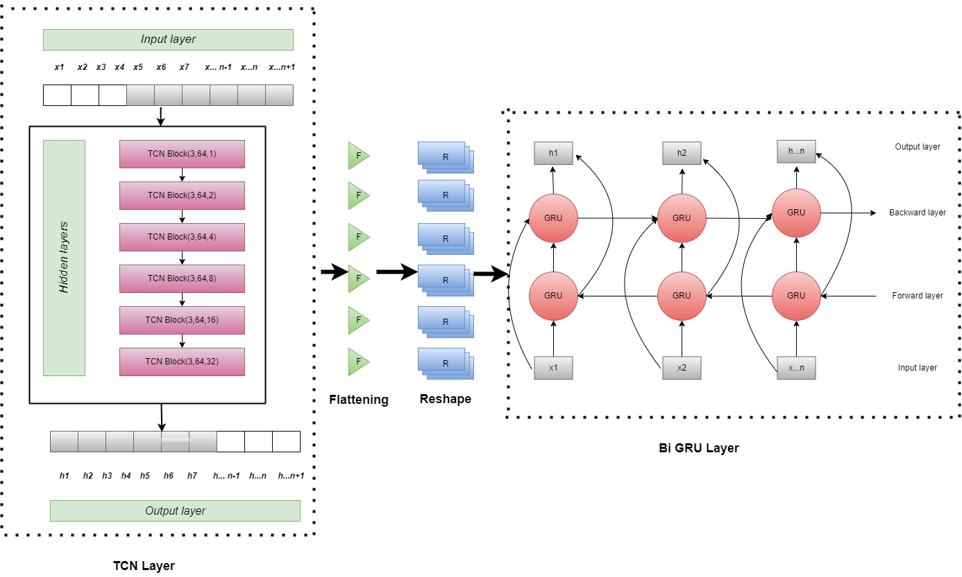
TCN BiGRU Architecture

Slide 25
References
J. Theis, W. L. Galanter, A. D. Boyd and H. Darabi, "Improving the In-Hospital Mortality Prediction of Diabetes ICU Patients Using a Process Mining/Deep Learning Architecture," in IEEE Journal of Biomedical and Health Informatics, vol. 26, no. 1, pp. 388-399, Jan. 2023.
T. Kondo et al., "Prediction of Short-Term Mortality of Cardiac Care Unit Patients Using Image-Transformed ECG Waveforms," in IEEE Journal of Translational Engineering in Health and Medicine, vol. 11, pp. 191-198, 2023.
S. Wang, H. Shen, Z. Liu and L. Xie, "TCN-Based Distal Force Feedback Strategy of a Vascular Interventional Surgery Robot," in IEEE Sensors Journal, vol. 24, no. 3, pp. 4120-4130, 1 Feb.1, 2024.
L. Tong, H. Ma, Q. Lin, J. He and L. Peng, "A Novel Deep Learning Bi-GRU-I Model for Real-Time Human Activity Recognition Using Inertial Sensors," in IEEE Sensors Journal, vol. 22, no. 6, pp. 6164-6174, 15 March15, 2022.
S. Ali, S. El-Sappagh, F. Ali, M. Imran and T. Abuhmed, "Multitask Deep Learning for Cost-Effective Prediction of Patient's Length of Stay and Readmission State Using Multimodal Physical Activity Sensory Data," in IEEE Journal of Biomedical and Health Informatics, vol. 26, no. 12, pp. 5793-5804, Dec. 2022

Slide 26
K. Psychogyios, L. Ilias, C. Ntanos and D. Askounis, "Missing Value Imputation Methods for Electronic Health Records," in IEEE Access, vol. 11, pp. 21562-21574, 2023
Yang, S., Cao, L., Zhou, Y. and Hu, C., 2023. A Retrospective Cohort Study: Predicting 90-Day Mortality for ICU Trauma Patients with a Machine Learning Algorithm Using XGBoost Using MIMIC-III Database. Journal of Multidisciplinary Healthcare.
J. Wu, X. Ye, C. Mou and W. Dai, "FineEHR: Refine Clinical Note Representations to Improve Mortality Prediction," 2023 11th International Conference on Digital Forensics and Security (ISDFS), Chattanooga, TN, USA, 2023, pp. 1-6
K. Zhang, K. Niu, Y. Zhou, W. Tai and G. Lu, "MedCT-BERT: Multimodal Mortality Prediction using Medical ConvTransformer-BERT Model," 2023 IEEE 35th International Conference on Tools with Artificial Intelligence (ICTAI), Atlanta, GA, USA, 2023, pp.
S. Wang, H. Shen, Z. Liu and L. Xie, "TCN-Based Distal Force Feedback Strategy of a Vascular Interventional Surgery Robot," in IEEE Sensors Journal, vol. 24, no. 3, pp. 4120-4130, 1 Feb.1, 2024

